Slide 1
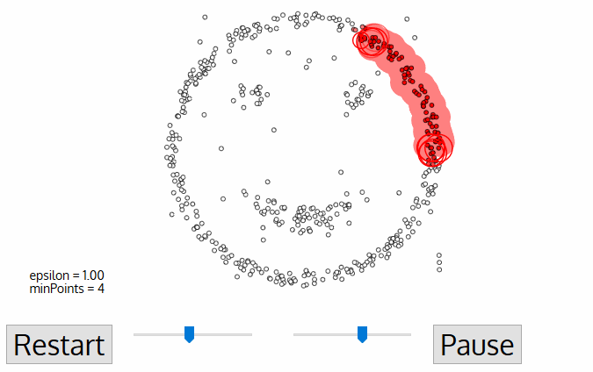
Density-Based Spatial Clustering of Applications with Noise (DBSCAN)
DBSCAN is a density-based clustered algorithm similar to mean-shift, but with a couple of notable advantages. Check out another fancy graphic below and let’s get started!

Slide 2
DBSCAN begins with an arbitrary starting data point that has not been visited. The neighborhood of this point is extracted using a distance epsilon ε (All points which are within the ε distance are neighborhood points).
If there are a sufficient number of points (according to minPoints) within this neighborhood then the clustering process starts and the current data point becomes the first point in the new cluster. Otherwise, the point will be labeled as noise (later this noisy point might become the part of the cluster). In both cases that point is marked as “visited”.
For this first point in the new cluster, the points within its ε distance neighborhood also become part of the same cluster. This procedure of making all points in the ε neighborhood belong to the same cluster is then repeated for all of the new points that have been just added to the cluster group.
This process of steps 2 and 3 is repeated until all points in the cluster are determined i.e all points within the ε neighborhood of the cluster have been visited and labeled.
Once we’re done with the current cluster, a new unvisited point is retrieved and processed, leading to the discovery of a further cluster or noise. This process repeats until all points are marked as visited. Since at the end of this all points have been visited, each point will have been marked as either belonging to a cluster or being noise.

