Slide 1
INTORDUCTION TO AGILE METHODOLOGY

Slide 2
“Simplicity is the ultimate sophistication”
Leonard Da Vinci

Slide 3

Being Agile
Move quickly
Travel light
Keep aware
Commit late
Respond to change
Don’t get overweight
Be good at following a moving target
Evolve and adapt to the local environment

Slide 4
Key drivers for implementing Agile software development processes
• Accelerating time-to-market
• Enhancing software quality
• Increasing productivity
• Improving alignment between IT and business objectives
• Improving project visibility
• Reducing cost
• Enhancing the ability to manage changing priorities
• Reducing project risk
• Reducing process complexity

Slide 5
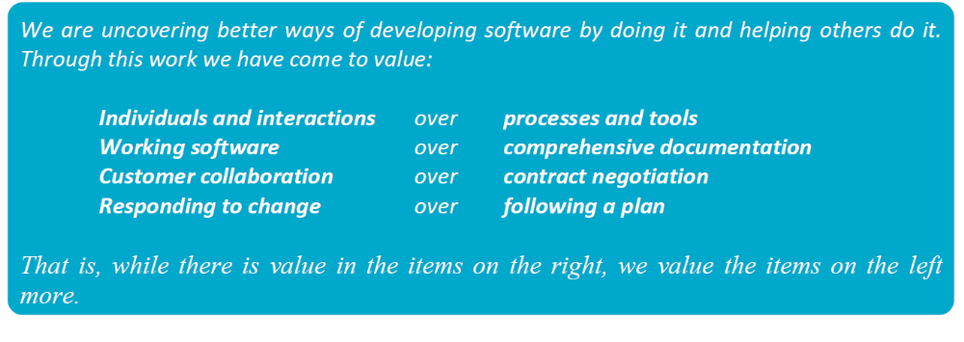

Slide 6
Agile
Iterative, incremental and evolutionary
Agile methods break tasks into small increments with minimal planning and do not directly involve long-term planning. Iterations are short time frames (timeboxes) that typically last from one to four weeks.
Each iteration involves a cross-functional team working in all functions: planning, requirements analysis, design, coding, unit testing, and acceptance testing. At the end of the iteration a working product is demonstrated to stakeholders.
This minimizes overall risk and allows the project to adapt to changes quickly. An iteration might not add enough functionality to warrant a market release, but the goal is to have an available release (with minimal bugs) at the end of each iteration. Multiple iterations might be required to release a product or new features.

Slide 7
Agile
Efficient and face-to-face communication
No matter what development disciplines are required, each agile team will contain a customer representative, e.g. Product Owner in Scrum. This person is appointed by stakeholders to act on their behalf and makes a personal commitment to being available for developers to answer mid-iteration questions.
At the end of each iteration, stakeholders and the customer representative review progress and re-evaluate priorities with a view to optimizing the return on investment (ROI) and ensuring alignment with customer needs and company goals.
In agile software development, an information radiator is a (normally large) physical display located prominently in an office, where passers-by can see it. It presents an up-to-date summary of the status of a software project or other product.^{[13][14]} The name was coined by Alistair Cockburn, and described in his 2002 book Agile Software Development.^{[14]} A build light indicator may be used to inform a team about the current status of their project.

Slide 8
Agile
Very short feedback loop and adaptation cycle
A common characteristic of agile development are daily status meetings or "stand-ups", e.g. Daily Scrum (Meeting). In a brief session, team members report to each other what they did the previous day, what they intend to do today, and what their roadblocks are.
Quality focus
Specific tools and techniques, such as continuous integration, automated unit testing, pair programming, test-driven development, design patterns, domain-driven design, code refactoring and other techniques are often used to improve quality and enhance project agility.

Slide 9
Agile Practices:
- “User Stories"
- Test Driven Development
- Refactoring
- Acceptance Testing
User Stories are written by the customers as things that the system needs to do for them.
They are also used instead of a large requirements document.

Slide 10
Agile Practices:
They are in the format of about three sentences of text written by the customer in the customers terminology without technical terminologies.
Refactoring is a disciplined technique for restructuring an existing body of code, altering its internal structure without changing its external behavior in a series of small behavior preserving transformations.

Slide 11
Agile Practices:
User stories also drive the creation of the acceptance tests.
One or more automated acceptance tests must be created to verify the user story has been correctly implemented.

Slide 12
Agile Testing Practices:
Conversational Test Creation
- Who, don’t do it alone, include prog and cust reps
Coaching Tests
UAT - User Stories into test cases in specific format,
specs by e.g..
Providing Test Interfaces
- Developers to include test interfaces (used for automation)
while coding
Exploratory Learning

Slide 13
Agile Testing Practices:
- Explore product, look for bugs, missing features and opp for dev,
Test-First Programming
- Developers write unit tests before coding.
- Improves design (reducing coupling and improving cohesion)
- Supports refactoring
- Refactoring requires unit tests to ensure that design changes
(refactorings) don’t break existing code.

