Slide 1
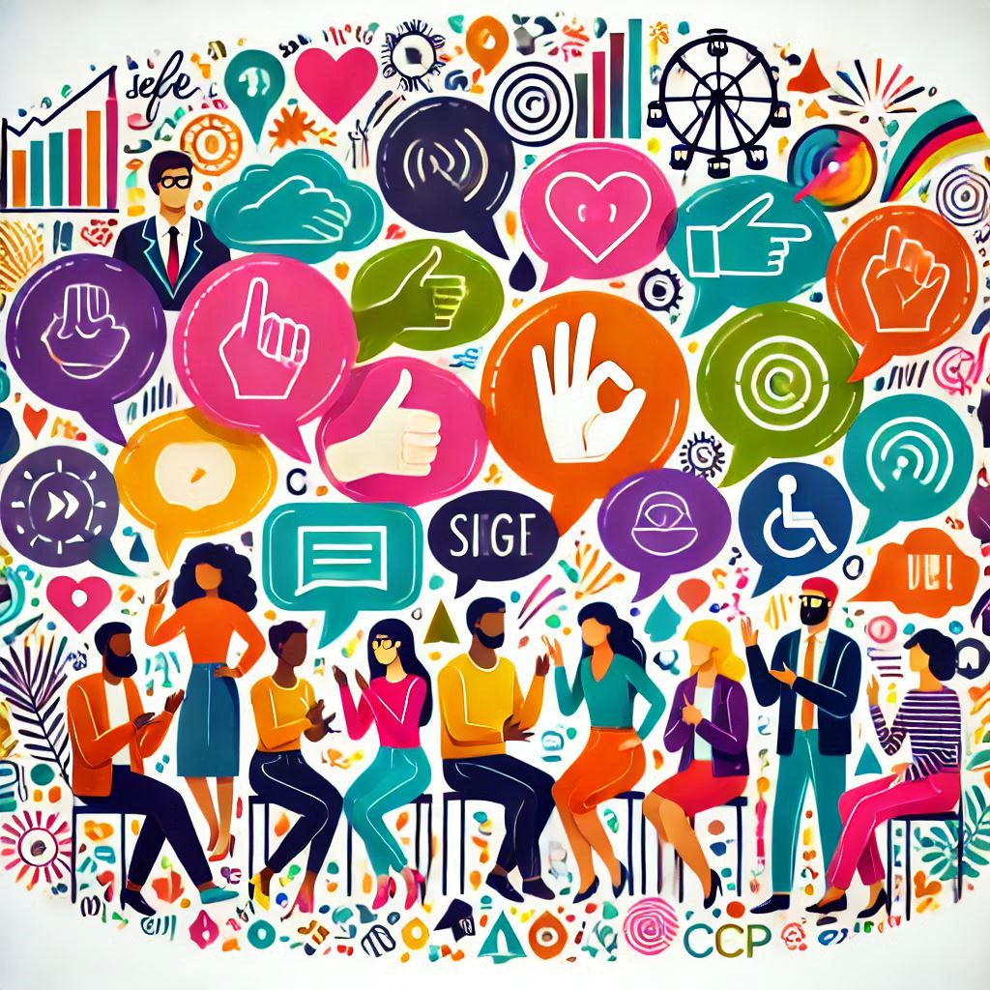
Role of Communication
Understanding the Significance

Slide 2
Significance of Communication
Communication is a fundamental aspect of human interaction that significantly influences various aspects of our lives.

Slide 3
Notes
Building Relationships
Personal Relationships:
Professional Relationships:
In a professional context, clear and consistent communication builds trust and rapport among colleagues, supervisors, and clients. It fosters a collaborative and supportive work environment.
Effective communication is the cornerstone of strong personal relationships. It allows individuals to express their emotions, share experiences, and understand each other's needs and perspectives.

Slide 4
Facilitating Collaboration and Teamwork
Coordination
Communication ensures that team members are aligned with their goals and understand their roles and responsibilities. It enables the coordination of tasks and the sharing of resources.
Problem-Solving
Through open dialogue, teams can brainstorm solutions, address challenges, and make collective decisions that benefit the entire group.

Slide 5
Enhancing Leadership
Inspiration
Leaders use communication to inspire and motivate their teams. Through speeches, meetings, and one-on-one interactions, leaders can share their vision and encourage others to achieve common goals.
Guidance
Effective leaders provide clear instructions and feedback, helping team members understand expectations and improve their performance.

Slide 6
Conflict Resolution
Understanding
Open communication helps individuals understand the root causes of conflicts. By discussing issues openly, parties can identify misunderstandings and work towards resolution.
Mediation
Mediators and conflict resolution professionals use communication techniques to facilitate dialogue and negotiate agreements between conflicting parties.

Slide 7
Decision Making
Information Sharing
Effective communication ensures that relevant information is shared with all stakeholders, enabling informed decision-making.
Consensus Building
Through discussions and deliberations, teams can reach a consensus that reflects the collective wisdom and preferences of the group.

Slide 8
Personal Growth and Development
Self-Expression
Communication allows individuals to express their thoughts, feelings, and ideas, contributing to self-awareness and personal growth.
Feedback Reception
Constructive feedback from others helps individuals recognize their strengths and areas for improvement, fostering continuous development.

Slide 9
Cultural Exchange and Understanding
Cultural Awareness
Communication across cultures promotes understanding and appreciation of diverse perspectives and practices.
Global Collaboration
In an increasingly interconnected world, effective cross-cultural communication is essential for global collaboration and problem-solving.

Slide 10
Innovation and Creativity
Idea Generation
Communication facilitates the exchange of ideas, leading to innovation and creative solutions.
Collaboration
Creative projects often require collaboration among individuals with diverse skills and perspectives, which is enabled by effective communication.

Slide 11
Information Dissemination
Education
Teachers and educators use communication to convey knowledge and foster learning.
Media and Journalism
The media plays a crucial role in disseminating information to the public, shaping opinions, and informing decision-making.

Slide 12
Emotional and Mental Well-being
Emotional Support
Open communication with friends, family, and mental health professionals provides emotional support and reduces feelings of isolation.
Stress Relief
Sharing concerns and discussing problems with others can alleviate stress and promote mental well-being.

Slide 13
End-Notes
The significance of communication cannot be overstated. It is a vital skill that impacts all areas of life, from personal relationships to professional success, and from conflict resolution to innovation.
By honing communication skills, individuals can enhance their effectiveness in various roles, contribute to collaborative efforts, and foster positive interactions in all aspects of their lives.

