Slide 1


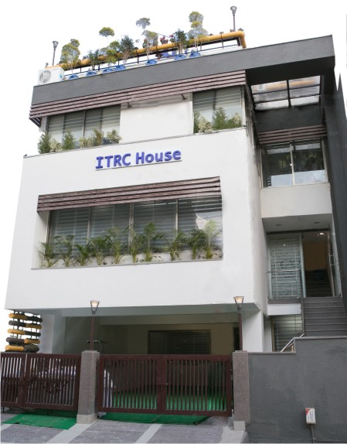
DAY: 01
Job Role:
Retail Sales Associates (RAS/Q0104-0103)
Level: II
Total Hours: 776
Domain Hrs: 560 (280/280

Slide 2

An Introduction
Retail is derived from French word ‘Retailer’ which refers to cutting off, clip and divide.
Retail is the sale of goods to end users, not for resale, but for use and consumption by the purchaser. The retail transaction is at the end of supply chain.
Manufacturers sell large quantities of products to retailers, and retailers attempt to sell those same quantities of products to consumers.
It is basically the sale of goods and services from individuals or businesses to the end user

Slide 3


Slide 4
Structure of Retail market in India
Organised and unorganised (Traditional) Retail
The total retail sector in India can be divided into organized and unorganized sectors.
The trading activities undertaken by licensed retailers are categorized as organized retailing. License retailers are those who are registered for sale tax, income tax, etc. These include the corporate-backed hypermarkets and retail chains, and also the privately owned large retail businesses.

Slide 5

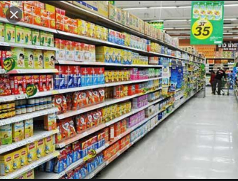
Unorganized retail or traditional retail on the other hand, include a large number of small retailers that consist of local kirana shops, owner-manned general stores, chemists, footwear shops, apparel shops, paan and beedi (local betel, leaf and tabacco) shops, hand-cart hawkers, pavement vendors, etc.
Unorganized Retail Organized Retail

Slide 6
Evolution of India Retail
The journey of retail started long back through the Kirana store in India.
This is first effort by local shopkeeper.
The shopping Centre concept comes into the existence in year 1869, with Mumbai Crawford market and Kolkata’s new market in year 1874.
The underground shopping complex Palika Bazaar in New Delhi was established in the late 1970s and mini malls on the Bangalore’s Brigade road come into existence in 1980s.

Slide 7
Government of India entered into the rural India by franchisees called Khadi Bhandar.
These stores serve as outlets for products made by village industry i.e. khadi, matchsticks, incense sticks, decorative items made from wood and earth, ahinsak (non-violent) honey, ahinsak leather items etc.
The industries came in the retailing in 1980s through dealer network.
In 1980s, the big group of textile industry i.e. Raymond, S.kumar, Bombay dyeing and Grasim came with this concept of retailing.

Slide 8
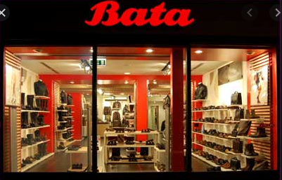

In the manufacturing sector, the pioneers were DCM group & Bata. Titan came with an organized retail concept and established number of showrooms for premium watches.
After the 2003, many other organizations either planning to come into the retail market through the retail store or initiated the establishment work.

Slide 9
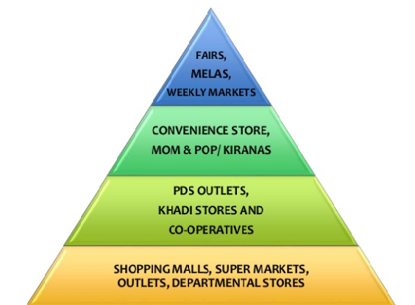
Evolution of Indian Retail

Slide 10
The Future of Retail
“The future is promising ; the market is growing, government policies are becoming more favourable and emerging technologies are facilitating operations”
Global giants ready to entre the retail market in India.
Modern retail in India could be worth US $ 1.1 trillion by 2020.

Slide 11
10 Top key players in India 2020
Reliance Retail Limited
Pantaloons Retail Limited
Provogue India Ltd.
Shoppers stop
ITC-LRBD
Trent Ltd.
McDonald’s
Aditya Birla Retail
Titan Industries
Kewel Kiran clothing Limited

Slide 12
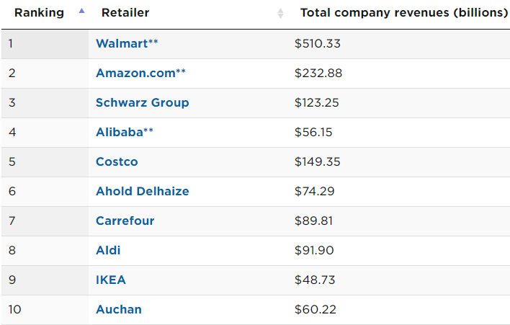
10 Global Retailers 2020

Slide 13



Who is Trainee Associate ?
Role of Trainee
The main role of a Trainee is to gain experience of all aspects of their selected career. These people can learn all required skills for their future jobs by doing different real work duties.

Slide 14



Responsibility of Trainee Associate
The Associate Trainee is responsible for the execution of assigned responsibilities within a specific area.

Slide 15
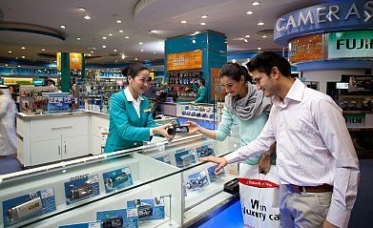
Who is Trainee Associate ?
A Trainee Associate is the crucial bridge between the consumer and the company. He / She provides personalized sales and post sales support to customers with an aim to maximize sales through exceptional customer service.

Slide 16


What is the role of an associate?
WHAT DO ASSOCIATES DO? Be a part of a team. Associates are usually members of a team of workers who collaborate to ensure that the clients' needs are being met. Some possible job titles include Customer Service Associate, Sales Associate, and Operations Associate.

Slide 17

Roles and Responsibilities of Trainee Associate
A Trainee Associate has to perform many different tasks to fulfill his roles and responsibilities. Few of the tasks that a Trainee Associate must always fulfill are:
Commitment towards works
Discipline
Grooming and Personality
Team work

Slide 18


Commitment towards works
Ability to appreciate and willingly follow company’s rules and regulations.
Always stand for what will protect company’s interest.

Slide 19


Discipline
Be punctual and regular
Follow instructions and orders of the superiors in order to progress

Slide 20


Grooming and personality
Follow the grooming standards and uniform policy of the company.
Always the enthusiastic, energetic and cheerful, and project oneself as an appropriate ambassador for the company.

Slide 21


Team work
Effectively work with yours colleagues.
Work with others as part of a team by supporting co-workers during busy trading periods so that ongoing customers service is maintained.
All the given points create a good first impression on both the customer and colleagues it also creates a good impression about you, allows you to impress others.

